Slide 1
Memorandum of guidance on the electricity at work regulations 1989
PHILIP WOOD 2017

Slide 2
Learning Outcomes
At the end of this session you should be able to:
State which Electricity at Work Regulations 1989 are Absolute or Reasonably Practical.
Be able to explain their use and importance within the electrical industry.

Slide 3
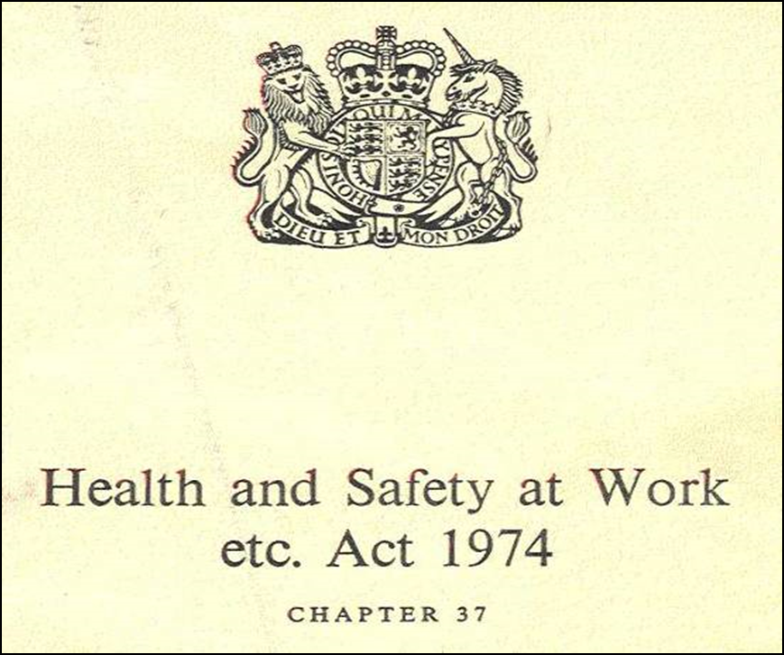
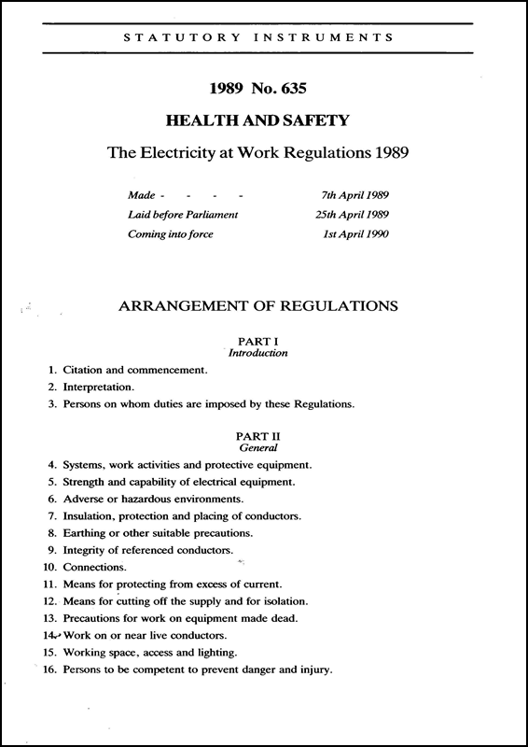
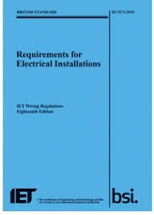
Statutory
Statutory
Non-Statutory

Slide 4

Electricity at work regulations 1989
Statutory (law, must be obeyed, fine and or imprisonment)

Slide 5
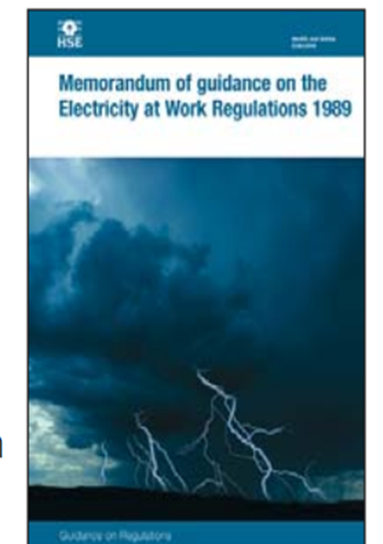

Health & Safety executive memorandum of guidance
Memorandum of Guidance on the Electricity at Work Regulations 1989

Slide 6

Before we look at the Electricity at Work Regulations let us consider some terminology defined in the Health & Safety at Work Act 1974

Slide 7

HEALTH & SAFETY AT WORK ACT 1974
Levels of Duty
1. An Absolute Duty
Indicated By Shall / Must
No Choice Shall / Must Will Be Complied With
An Example of An Absolute Duty is Reg 5 of “The Electricity at Work Regulations 1989” (EAWR 89)
“No Electrical equip etc,,,,,,,,,,,,,

Slide 8
HEALTH & SAFETY AT WORK ACT 1974
Levels of Duty
2. As Far As Practicable (AFAP)
There is No Actual Definition But It Has Been Taken By The Courts To Mean
That Which Is Possible
In The Light Of Current Knowledge And Invention (In The Mind Of The Court)

Slide 9
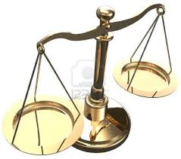
HEALTH & SAFETY AT WORK ACT 1974
Levels of Duty
So Far As Is Reasonably Practicable (SFARP)
Benefits
Health & Safety Benefits
Time Money Effort
Costs

Slide 10

Any Questions?

Slide 11


Slide 12

Electricity at work regulations 1989
Circuit Conductor:
means any conductor in a system which is intended to carry electric current in normal conditions, or to be energised in normal conditions and includes a combined neutral and earth conductor, but does not include a conductor provided solely to perform a protective function by connection to earth or other reference point.

Slide 13
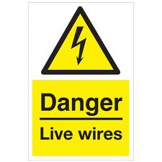

Electricity at work regulations 1989
Danger:
Injury:
Risk of injury
Potential harm/death to people
Electrical injury examples?
Explosions
Electrical arcing
Electric shock
Electric burns
Electrical fires

Slide 14
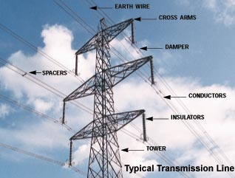
Electricity at work regulations 1989
Electrical Equipment:
Includes anything used, intended to be used or installed for use, to generate, provide, transmit, transform, rectify, convert, conduct, distribute, control, store, measure or use electrical energy.

Slide 15
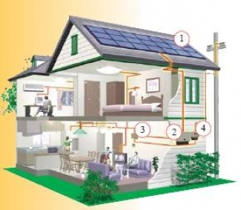
Electricity at work regulations 1989
System:
An electrical system in which all the electrical equipment is, or may be, electrically connected to a common source of electrical energy, and includes such source and such equipment.

Slide 16
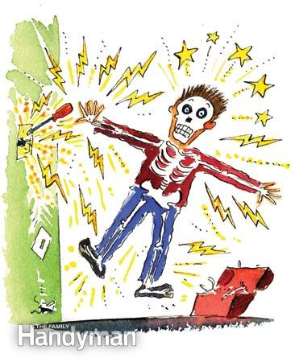

Electricity at work regulations 1989
Charged/Live
The terms `charged' and `live' have different meanings; they are not defined in the Regulations so they take their ordinary meaning.
Live means that the item in question is at a voltage, by being connected to a source of electricity for example as in normal use.
Charged means that the item has acquired a charge either because it is live or because it has become charged by other means such as by static or induction charging, or has retained or regained a charge due to capacitance effects - even though it may be disconnected from the rest of the system.

Slide 17
Electricity at work regulations 1989
Dead:
The term `dead' is not defined in the Regulations so it takes its ordinary meaning. Thus, in the context of the Regulations, for a conductor to be `dead' means that it is neither `live' nor `charged'.

Slide 19
Electricity at work regulations 1989
Summary of the regulations

Slide 20



Electricity at work regulations 1989
Regulation 3:
Persons on whom duties are imposed by these regulations.
Places duties on employers,
employees
and the self-employed.
Known as DUTY HOLDERS

Slide 21
Electricity at work regulations 1989
Regulation 4:
Systems, work activities and protective equipment.
Requires electrical systems and equipment to be constructed so that persons are not exposed to DANGER. This requires account to be taken of the environment in which the system will operate, the protective devices installed and how testing and maintenance should be carried out.
Maintenance must be carried out to ensure the safety of the system. This should include regular inspections, tests and the keeping of records of the maintenance. The frequency of maintenance will be dictated by the need to prevent DANGER from the system.
Finally all work activities associated with the operation, use and maintenance of systems must be carried out safely and using, where appropriate, suitable protective equipment.

Slide 22
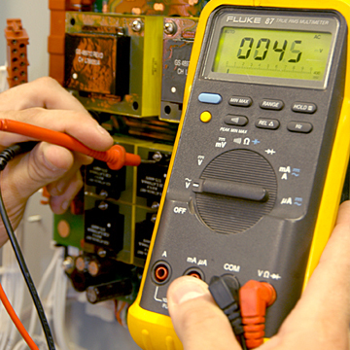
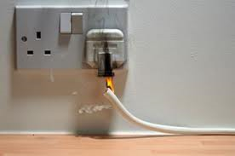
Electricity at work regulations 1989
Regulation 5:
Strengths and capability of electrical equipment
System to be capable of withstanding the effects of normal use and those produced as a result of a fault condition.

Slide 23
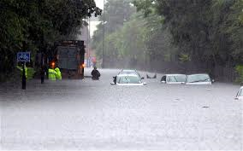
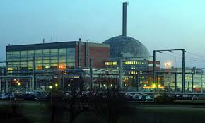
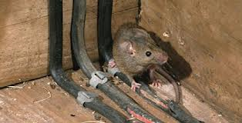
Electricity at work regulations 1989
Regulation 6:
Adverse or hazardous environments.
Systems to be constructed and protected to withstand the effects of such things as the weather, hazardous environments and damage.

Slide 24
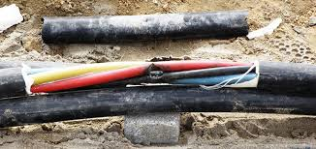
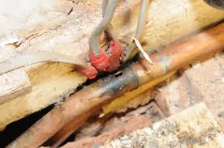
Electricity at work regulations 1989
Regulation 7:
Insulation, protection and placing of conductors.
Requires DANGER to be prevented by insulating, physically separating or suitably locating the conductors of a system.

Slide 25
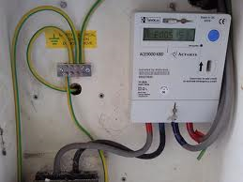
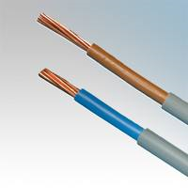

Electricity at work regulations 1989
Regulation 8:
Earthing or other suitable precautions.
Precautions to be taken to prevent DANGER arising from contact with exposed conductive parts such as the outer metal casing of equipment. Prevention can be achieved by earthing, double insulating or the use of "safe" voltages.

Slide 26
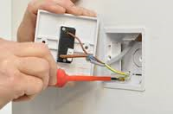
Electricity at work regulations 1989
Regulation 9:
Integrity of referenced conductors.
The need to preserve the integrity of "referenced" conductors (e.g. conductors connected to earth).

Slide 27
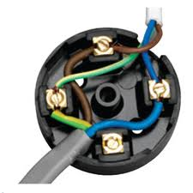
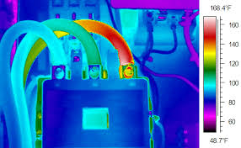
Electricity at work regulations 1989
Regulation 10:
Connections
Requires all joints and connections to be sound i.e. suitable for the purpose to prevent local "hot spots".

Slide 28
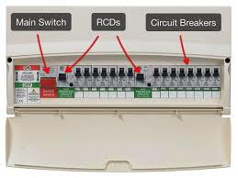
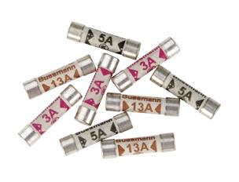
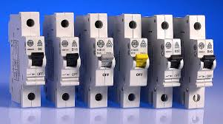
Electricity at work regulations 1989
Regulation 11:
Means for protecting from excess of current
The need to protect systems from faults and overloads.

Slide 29
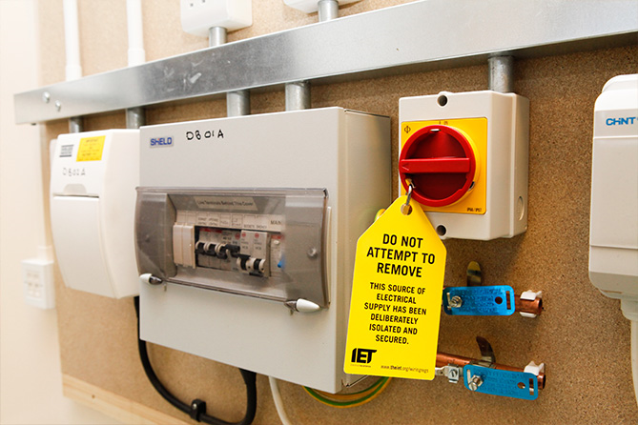
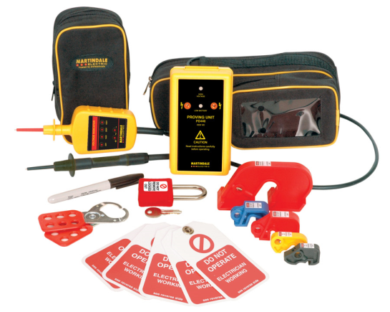
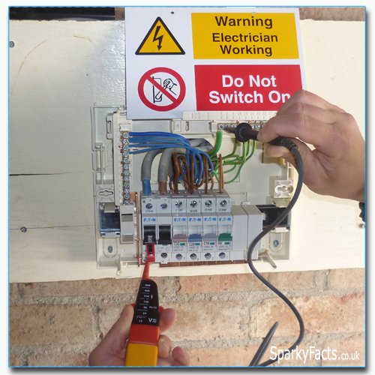
Electricity at work regulations 1989
Regulation 12:
Means for cutting off the supply and for isolation
Requires systems to be capable of being switched off AND isolated - the basics of safe system of work.

Slide 30
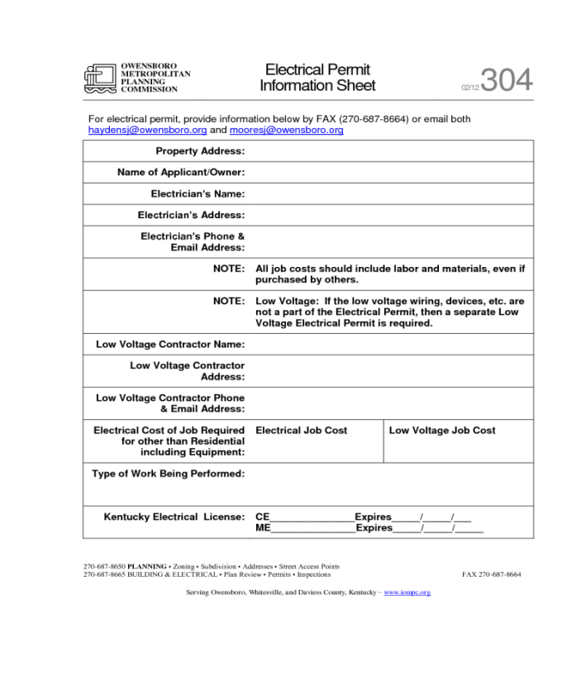
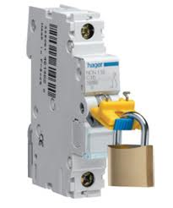
Electricity at work regulations 1989
Regulation 13:
Precautions for work on equipment made dead
Precautions for work on equipment made "DEAD" e.g. locking off and permit-to-work procedures.

Slide 31
Electricity at work regulations 1989
Regulation 14:
Work on or near live equipment
THE BIG ONE! - Work ON or NEAR live conductors.
“No person shall be engaged in any work activity on or so near any live conductor (other than one suitably covered with insulating material so as to prevent danger) that danger may arise unless –”
(a) “it is unreasonable in all circumstances for it to be dead”; and….
(b) “it is reasonable in all the circumstances for him to be at work on or near it while it is live”; and….
(c) “suitable precautions (including where necessary the provision of suitable protective equipment) are taken to prevent injury”

Slide 32
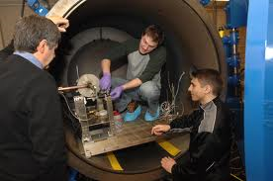
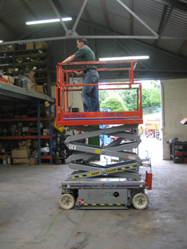
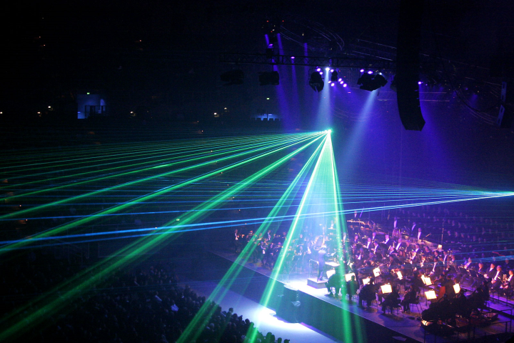
Electricity at work regulations 1989
Regulation 15:
Working space, access and lighting
Requires adequate working space, access and lighting when working ON or NEAR electrical equipment.

Slide 33
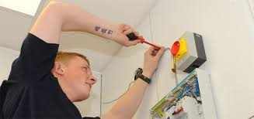
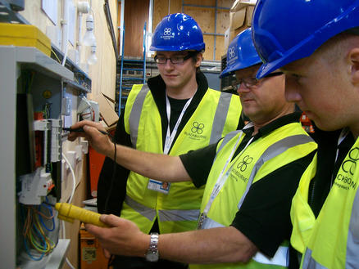
Electricity at work regulations 1989
Regulation 16:
Persons to be competent to prevent danger and injury
The need to select, train and supervise staff who should be experienced in working on electrical equipment (or be suitably supervised if being trained).
Competence:
Knowledge
Training
Qualification
Experience
Skill

Slide 34

Electricity at work regulations 1989
Regulation 29:
Defence
In criminal proceedings, it provides a defence for a duty holder if it can be established that the duty holder took all reasonable steps and exercised due diligence to avoid committing offences under some of the regulations.

Slide 35



